Slide 1
Exploratory Data Analysis (EDA)

Slide 2
Correlation
When two sets of data are strongly linked together we say they have a high correlation.
Correlation is Positive when the values increase together, and
Correlation is Negative when one value decreases as the other increases.
Correlation can have a value ranging from:
1 is perfect positive correlation
0 implies that there is no correlation
-1 is perfect negative correlation

Slide 3
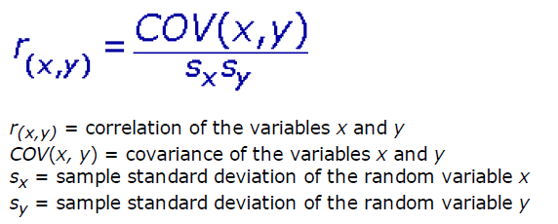
Correlation

Slide 4
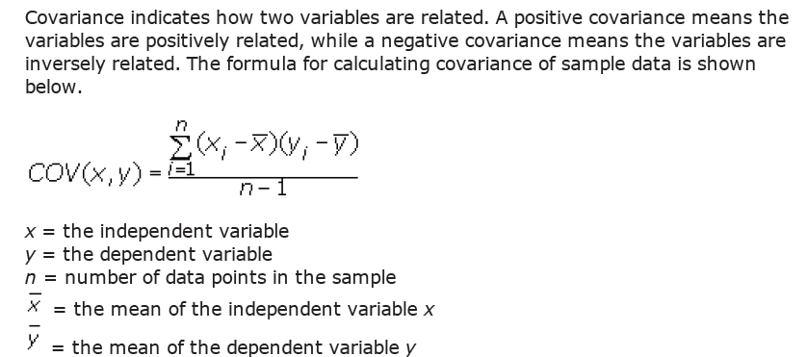
Covariance

Slide 5
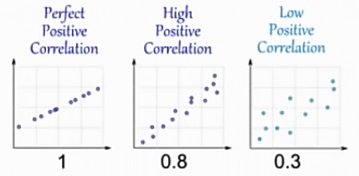
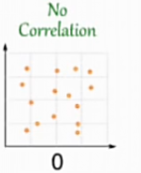
Correlation
1 is perfect positive correlation
0 implies that there is no correlation

Slide 6
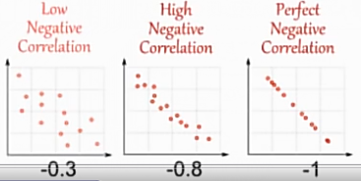
Correlation
-1 is perfect negative correlation
Correlation Does Not Imply Causation !!!!
Example: As ice cream sales increase, the rate of drowning deaths increases sharply. Therefore, ice cream consumption causes drowning.
Notes:
As ice cream sales increase, the rate of drowning deaths increases sharply.
Therefore, ice cream consumption causes drowning.
This example fails to recognize the importance of time of year and temperature to ice cream sales. Ice cream is sold during the hot summer months at a much greater rate than during colder times, and it is during these hot summer months that people are more likely to engage in activities involving water, such as swimming. The increased drowning deaths are simply caused by more exposure to water-based activities, not ice cream. The stated conclusion is false.

Slide 7
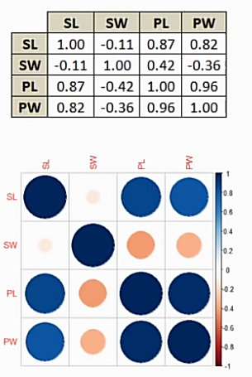
Correlation
The creation of a correlation matrix and
correlation heat maps make it easier to
have a top level view of the data.
Remember that data that is closer to
perfect negative or positive correlations
will be stronger for linear model building.
We need to be careful about the assuming
that lower correlation intervals are
potentially poor variables for model
building.
Evaluation of correlation should be handled on a case by case basis.
Notes:
❖ Example: In behavioral sciences, it is not uncommon to have correlations between 0.3 and 0.4 for significant variables.

Slide 8
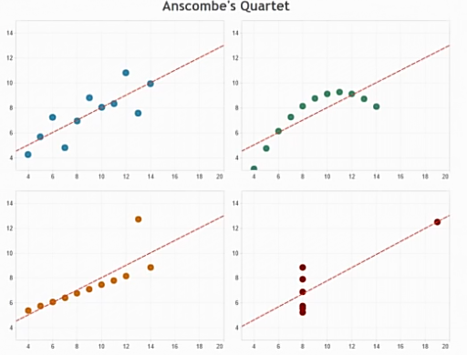
Understanding the Data
This is a powerful example on why we need to understand the data in order to model the information correctly.

Slide 9
Understanding the Data
Anscombe’s quartet shows how different data spreads can produce identical summary statistics, e.g. mean, variance, correlation coefficients, moreover the line of best fit (regression models).
These are the same models
with identical mean, variance,
and correlation values.
Some of these models
requires data transformations
to achieve linearity, others
have outliers that strongly
influence the models performance.

Slide 10
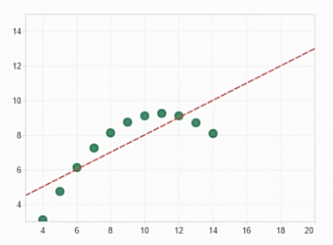
Fundamentals of Transformations
When data in a scatterplot indicates that a non-linear relationship exists between the dependent and independent variable, we can use a data transformation to achieve linearity.
Here are some types of
transformations we will go over:
Power Function
Exponential Function
Polynomial Function
Logarithmic Function
Square Root Function

Slide 11
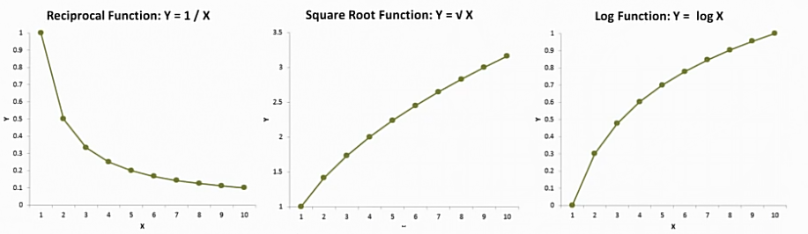
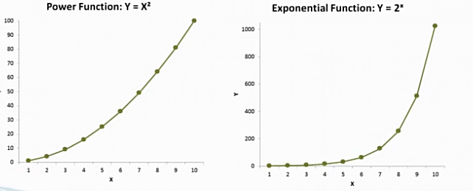
Fundamentals of Transformations

Slide 12
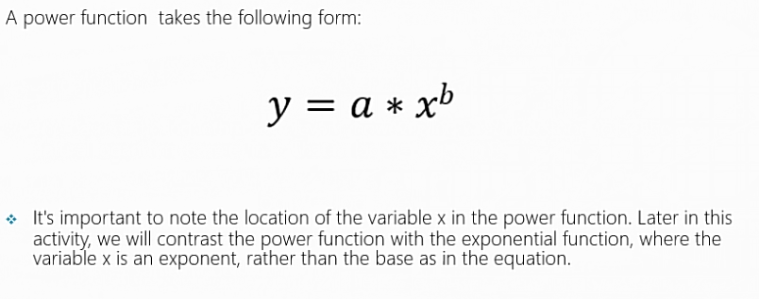
Fundamentals of Transformations

Slide 13
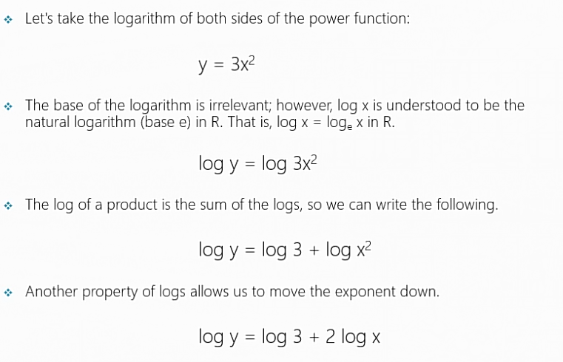
Power Function

Slide 14
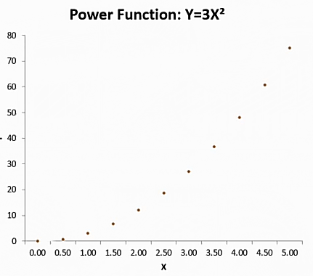
Power Function

Slide 15
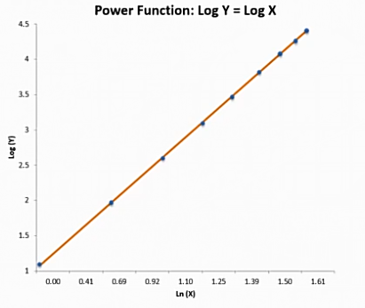
Power Function

Slide 16
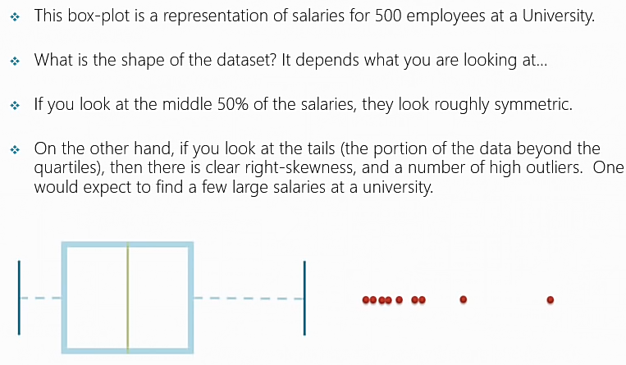
Power Function

Slide 17
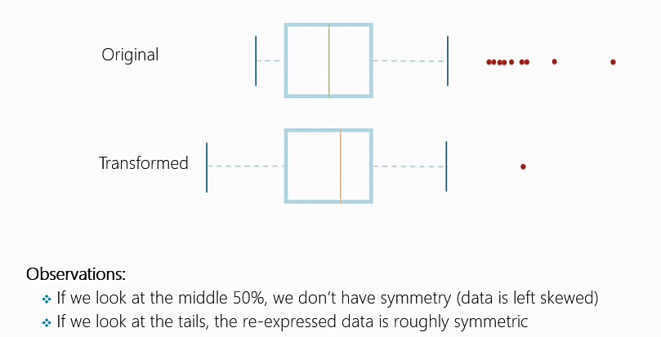
Power Function

Slide 18
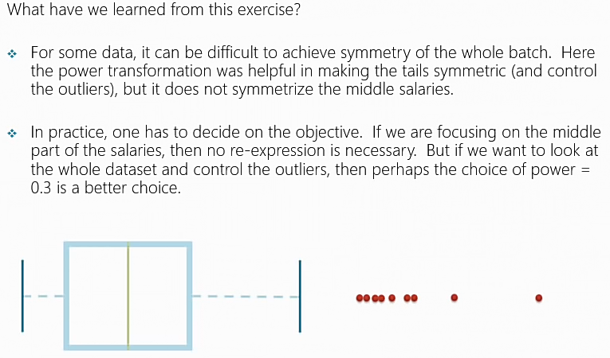
Power Function

Slide 19
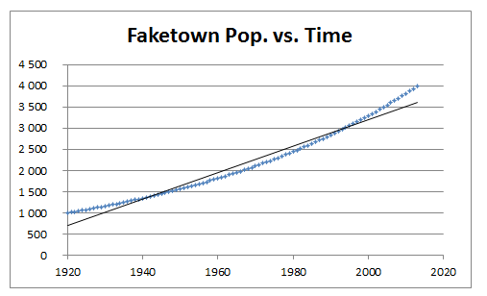
Transformation example: Population Growth

Slide 20
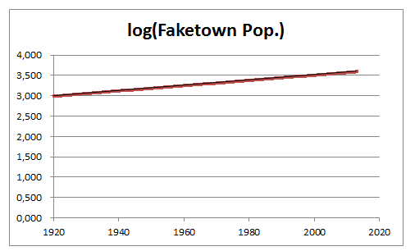
Transformation example: Population Growth

Slide 21
Transformation example: Fortune 500 CEO salaries

Slide 22
Transformation example: Fortune 500 CEO salaries

Slide 23
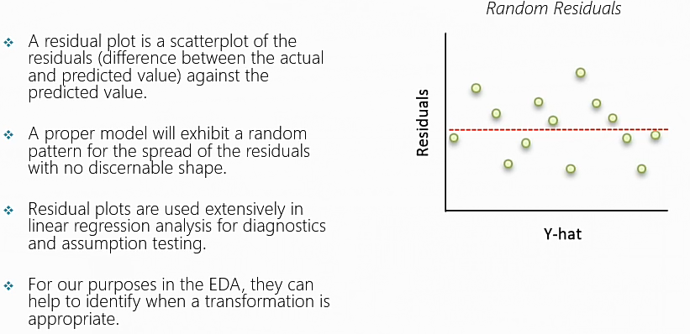
Residual Plots
A “good” residuals vs. fitted plot should be relatively shapeless without clear patterns in the data, no obvious outliers, and be generally symmetrically distributed around the 0 line without particularly large residuals.
Residual = Actual value - Predicted value
Both the sum and the mean of the residuals are equal to zero

Slide 24

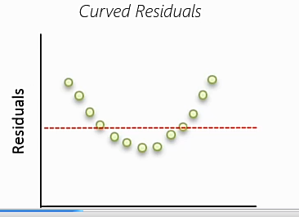
Residual Plots

Slide 25
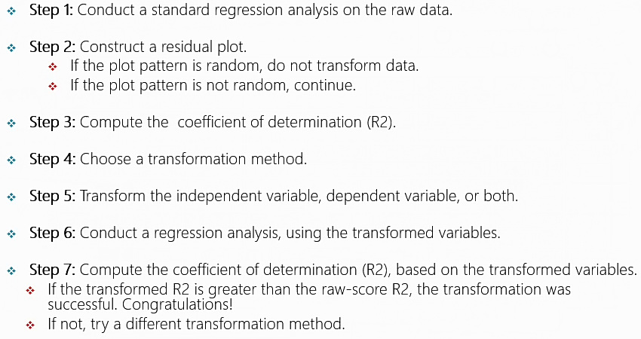
Transformation Guide
Notes:
In statistics, the coefficient of determination, denoted R² or r² and pronounced "R squared", is the proportion of the variance in the dependent variable that is predictable from the independent variable(s).
In other words “How much (What %) of the total variation in Y is described (predicted) by the regression line (variation in X)?”

Slide 26
R² (Coefficient of determination)
In statistics, the coefficient of determination, denoted R² or r² and pronounced "R squared", is the proportion of the variance in the dependent variable that is predictable from the independent variable(s).
In other words “How much (What %) of the total variation in Y is described (predicted) by the regression line (variation in X)?”
SE_{Ῡ} = (Y – Ῡ)²
Se_{line} = (Actual Y – Predicted Y)²
Proportion of the variance not predictable: SE_{line}/SE_{Ῡ}
coefficient of determination R² = 1- (SE_{line}/SE_{Ῡ})
Notes:
In statistics, the coefficient of determination, denoted R² or r² and pronounced "R squared", is the proportion of the variance in the dependent variable that is predictable from the independent variable(s).
In other words “How much (What %) of the total variation in Y is described (predicted) by the regression line (variation in X)?”

Slide 27
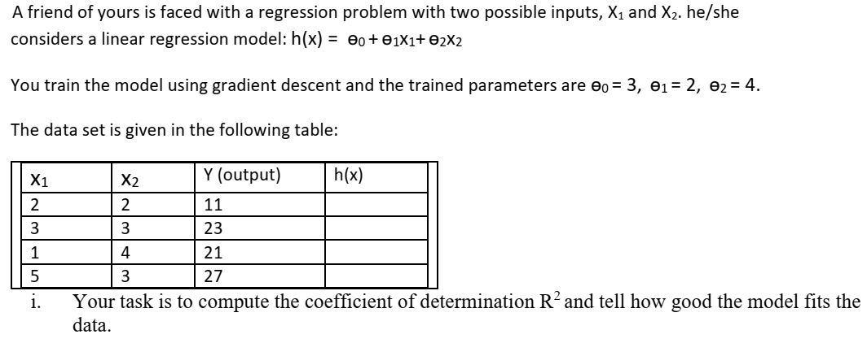
Task 1: Compute R²

Slide 28
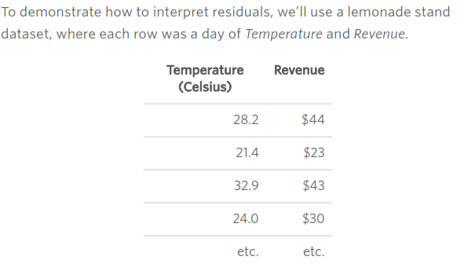
Interpreting Residual Plots to improve your Regression
Observations, Predictions, and Residuals
Notes:
The regression equation describing the relationship between Temperature and Revenue is
Revenue = 2.7 * Temperature – 35

Slide 29
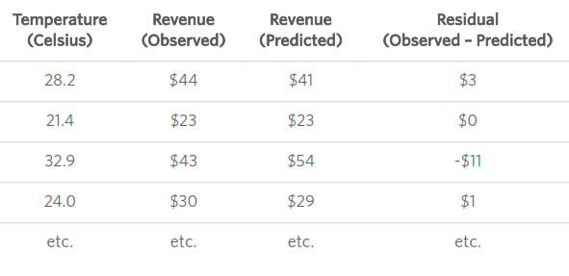
Interpreting Residual Plots to improve your Regression
Revenue = 2.7 * Temperature – 35

Slide 30
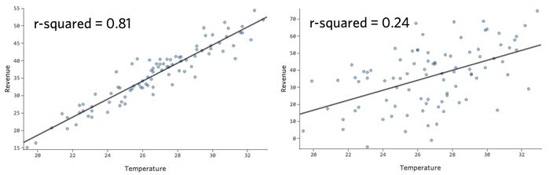
Understanding Accuracy with Observed vs Predicted

Slide 31
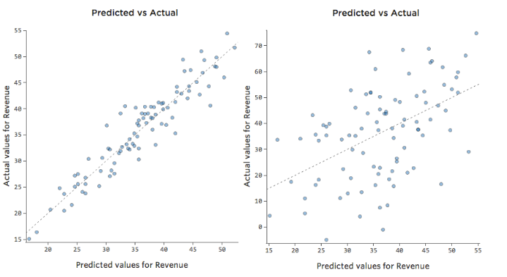
Understanding Accuracy with Observed vs Predicted
For more than one explanatory variables

Slide 32
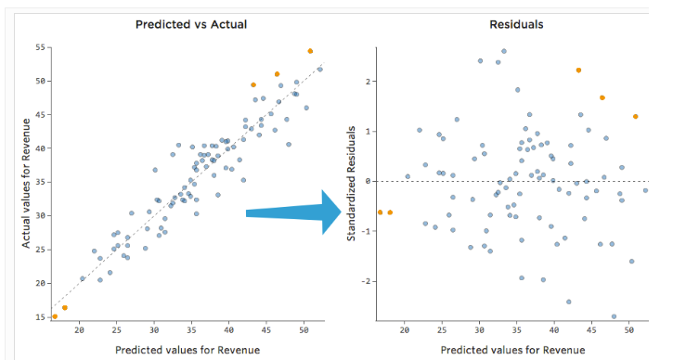
Examining Predicted vs Residual (“The Residual Plot”)
Notes:
In this plot (on the right) each point is one day, where the prediction made by the model is on the x-axis, and the accuracy of the prediction is on the y-axis. The distance from the line at 0 is how bad the prediction was for that value.
Since…
Residual = Observed – Predicted
…positive values for the residual (on the y-axis) mean the prediction was too low, and negative values mean the prediction was too high; 0 means the guess was exactly correct.

Slide 33
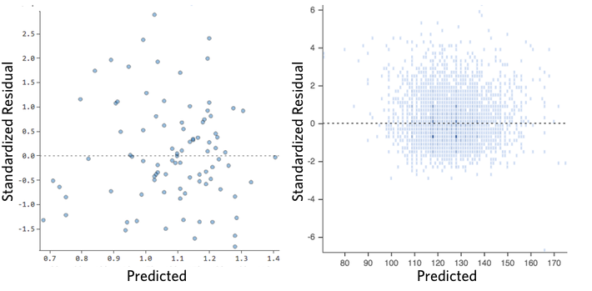
Examining Predicted vs Residual (“The Residual Plot”)
Ideally your plot of the residuals look like one of these:

Slide 34
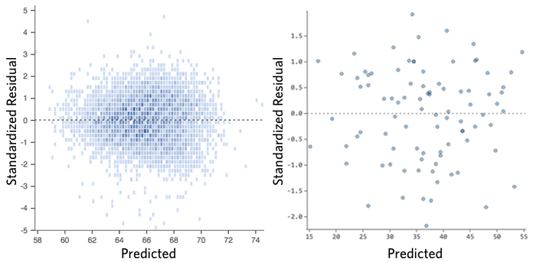
Examining Predicted vs Residual (“The Residual Plot”)
That is,
(1) they’re pretty symmetrically distributed, tending to cluster towards the middle of the plot
(2) they’re clustered around the lower single digits of the y-axis (e.g., 0.5 or 1.5, not 30 or 150)
(3) in general there aren’t clear patterns
Notes:
A “good” residuals vs. fitted plot should be relatively shapeless without clear patterns in the data, no obvious outliers, and be generally symmetrically distributed around the 0 line without particularly large residuals.

Slide 35
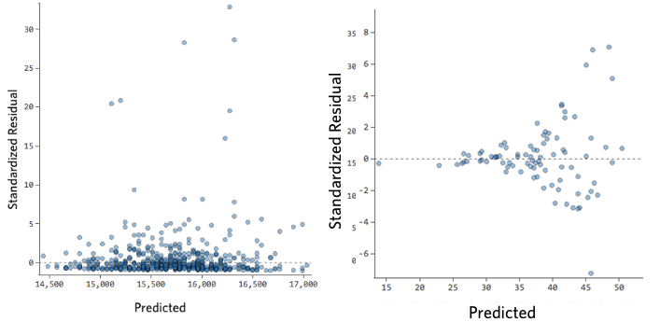
Examining Predicted vs Residual (“The Residual Plot”)
Here’s some residual plots that don’t meet those requirements:
Heteroscedasticity
Notes:
Non-constant spread of the residuals, such as a tendency for more clustered residuals for small h(x) and more dispersed residuals for large h(x). It indicates heteroscedasticity or non-constant variance. The usual remedy is a transformation of the response.

Slide 36
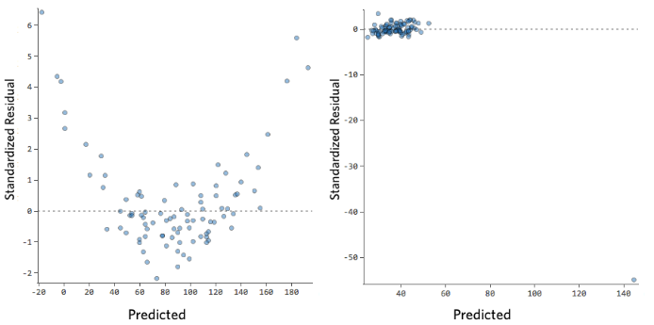
Examining Predicted vs Residual (“The Residual Plot”)
Here’s some residual plots that don’t meet those requirements:

Slide 37
Examining Predicted vs Residual (“The Residual Plot”)
These plots aren’t evenly distributed vertically, or they have an outlier, or they have a clear shape to them.
If you can detect a clear pattern or trend in your residuals, then your model has room for improvement.

Slide 38
Examining Predicted vs Residual (“The Residual Plot”)
These plots aren’t evenly distributed vertically, or they have an outlier, or they have a clear shape to them.
If you can detect a clear pattern or trend in your residuals, then your model has room for improvement.

Slide 39
Examining Predicted vs Residual (“The Residual Plot”)
Any trend in the plot, such as a tendency for negative residuals at small predicted value (h(x)) and positive residuals at large h(x). Such a trend would indicate non-linearities in the data. Possible remedies include transforming the response or introducing polynomial terms on the predictors.
Non-constant spread of the residuals, such as a tendency for more clustered residuals for small h(x) and more dispersed residuals for large h(x). It indicates heteroscedasticity or non-constant variance. The usual remedy is a transformation of the response.

Slide 40
How much does this matter?
“Essentially, all models are wrong, but some are useful”
George Box
How concerned should you be if your model isn’t perfect, if your residuals look a bit unhealthy?
It’s up to you.
If you’re publishing your thesis in particle physics, you probably want to make sure your model is as accurate as humanly possible.
If you’re trying to run a quick and dirty analysis of your friend’s lemonade stand, a less-than-perfect model might be good enough to answer whatever questions you have (e.g., whether Temperature appears to affect Revenue).

Slide 41
How much does this matter?
Most of the time a decent model is better than none at all. So take your model, try to improve it, and then decide whether the accuracy is good enough to be useful for your purposes.

Slide 42
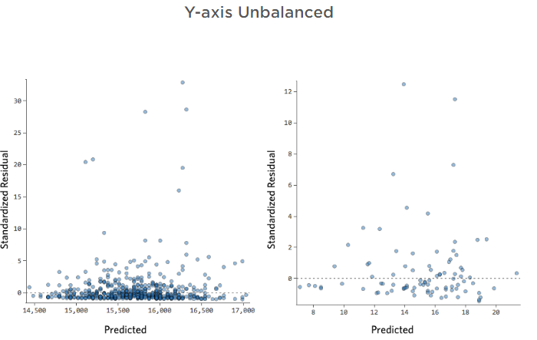
Examples of Residual Plots and their Diagnoses
Below is a gallery of unhealthy residual plots. Your residual may look like one specific type from below, or some combination.

Slide 43
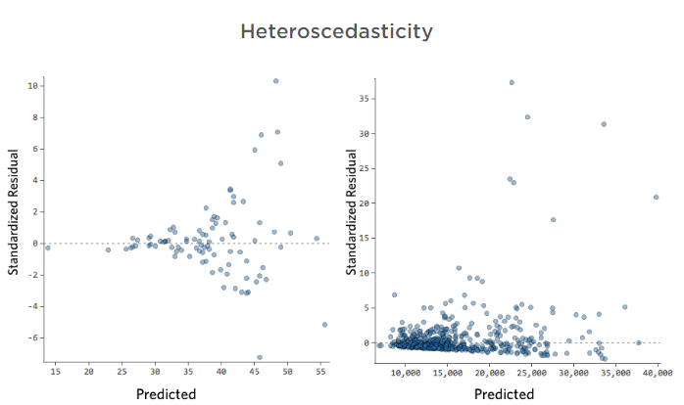
Examples of Residual Plots and their Diagnoses
unhealthy residual plots:

Slide 44
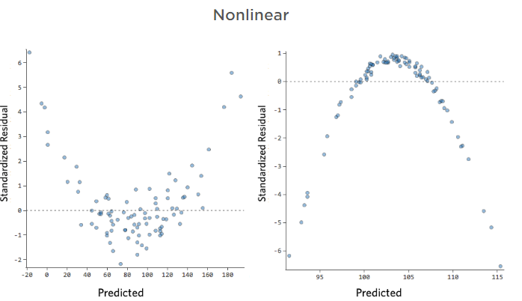
Examples of Residual Plots and their Diagnoses
unhealthy residual plots:

Slide 45
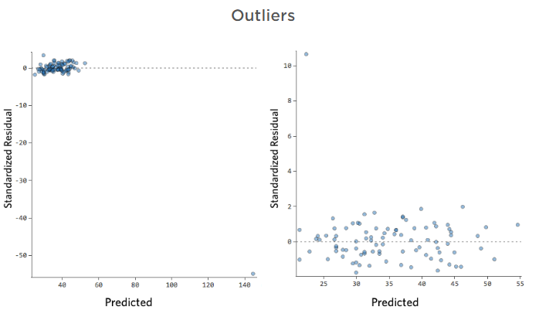
Examples of Residual Plots and their Diagnoses
unhealthy residual plots:

Slide 46
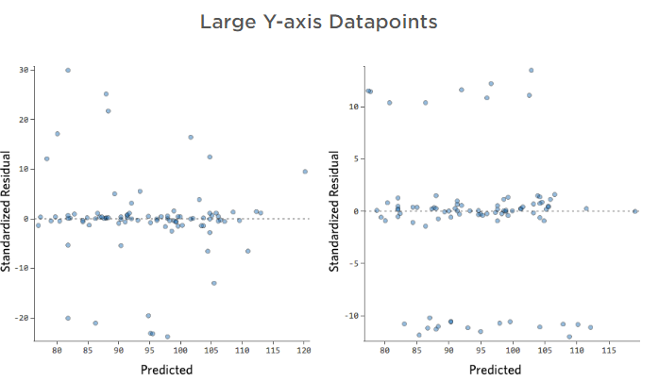
Examples of Residual Plots and their Diagnoses
unhealthy residual plots:

Slide 47
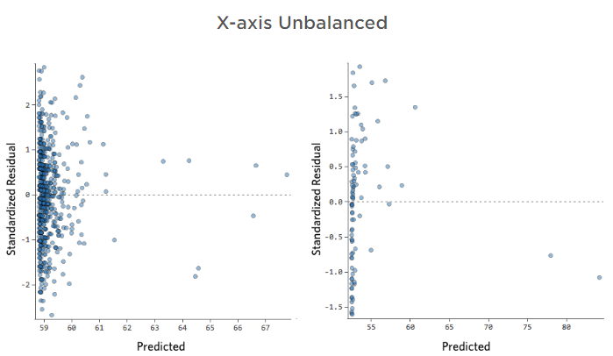
Examples of Residual Plots and their Diagnoses
unhealthy residual plots:

Slide 48
Ways to improve your Model
Assessing the impact of an outlier
Transforming Variables
Missing Variables
Fixing non-linearity

Slide 49
Ways to improve your Model
Assessing the impact of an outlier
Assume that you have an outlying datapoint that is legitimate, not a measurement or data error
To decide how to move forward, you should assess the impact of the datapoint on the regression.
The easiest way to do this is to note the coefficients of your current model, then filter out that datapoint from the regression. If the model doesn’t change much, then you don’t have much to worry about.
If that changes the model significantly, examine the model, and particularly Actual vs Predicted, and decide which one feels better to you.
It’s okay to ultimately discard the outlier as long as you can theoretically defend that, saying “In this case we’re not interested in outliers, they’re just not of interest,” or “That was the day Uncle XYZ came by and tipped me $200; that’s not predictable, and it’s not worth including in the model.”

Slide 50
Ways to improve your Model
Transforming Variables
The most common way to improve a model is to transform one or more variables, usually using a “log” transform.
Transforming a variable changes the shape of its distribution.
Typically the best place to start is a variable that has an asymmetrical distribution, as opposed to a more symmetrical or bell-shaped distribution.

Slide 51
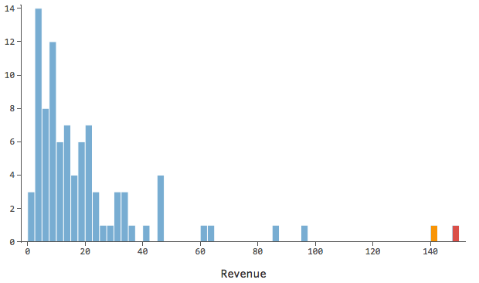
Transforming Variables
So find a variable like this to transform:
Notes:
We’ve colored a couple outlying datapoints red and orange so you can see how their distance from the rest of the data changes after we transform the data.

Slide 52
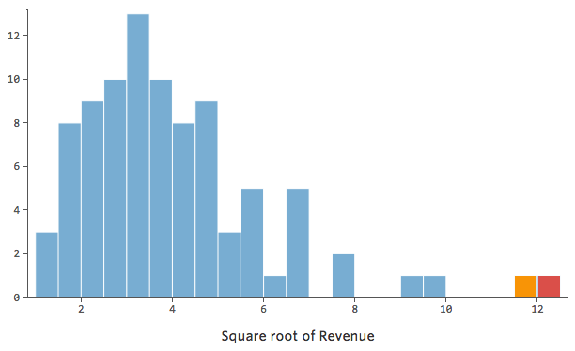
Transforming Variables
In general, regression models work better with more symmetrical, bell-shaped curves.
Try different kinds of transformations until you hit upon the one closest to that shape. It’s often not possible to get close to that, but that’s the goal.
So let’s say you take the
square root of Revenue as an
attempt to get to a more
symmetrical shape, and your
distribution looks like this:
That’s good, but it’s still
a bit asymmetrical.

Slide 53
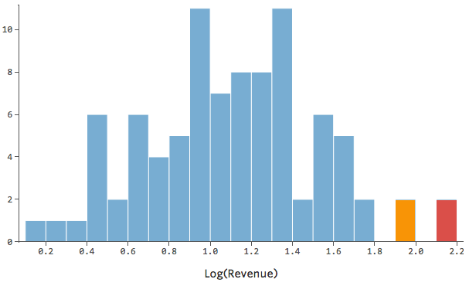
Transforming Variables
Let’s try taking the log of revenue instead, which yields this shape:
That’s nice and symmetrical.
You’re probably going to get a better regression model with log(Revenue) instead of Revenue.

Slide 54
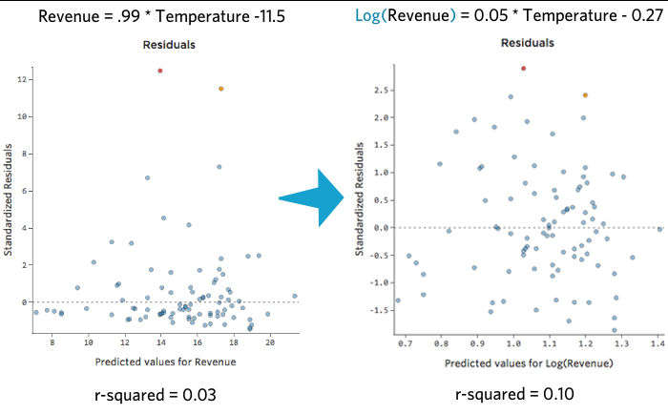
Transforming Variables
here’s how your equation, your residuals, and your r-squared might change:

Slide 55
Ways to improve your Model
Missing Variables
Probably the most common reason that a model fails to fit is that not all the right variables are included.
This particular issue has a lot of possible solutions.
Adding a New Variable
Sometimes the fix is as easy as adding another variable to the model.
For example if lemonade stand Revenue was much larger traffic was much larger on weekends than week days, your Predicted vs Actual plot might look like the given in next slide (r-squared of 0.053), since the model is just taking the average of weekend days and weekdays:

Slide 56
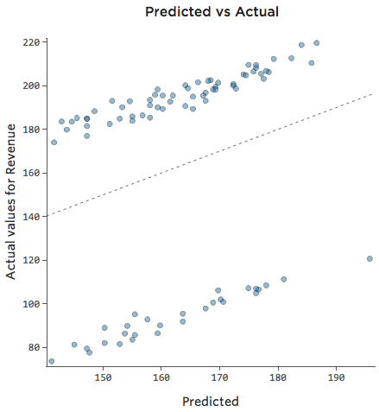
Ways to improve your Model
Missing Variables
Adding a New Variable

Slide 57
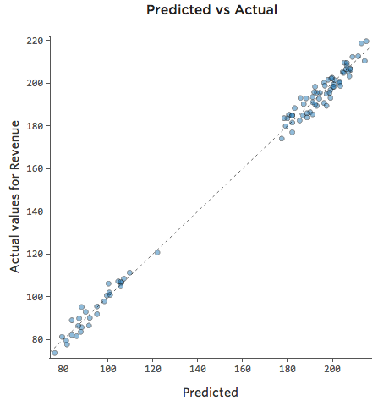
Ways to improve your Model
Missing Variables
Adding a New Variable
If the model includes a variable
called Weekend?, then the
Predicted vs Actual plot
might look like this
(r-squared of 0.974):
Notes:
The model makes far more accurate predictions because It’s able to take into account whether a day of the week is a weekday or not.
Note that sometimes you’ll need to create variables to improve your model in this fashion. For example, you might have had a Date variable (with values like “10/26/2014”) and you might need to create a new variable called Day of Week (“Sunday”) or Weekend? (“Weekend”).

Slide 58
Ways to improve your Model
Missing Variables
Unavailable Omitted Variable
Sometimes the relevant variable isn’t available because you don’t know what it is, or it was difficult to collect. Maybe it wasn’t a weekend-vs-weekday issue, but instead something like Number of Competitors in the Area that you failed to collect at the time.
If the variable you need is unavailable, or you don’t even know what it would be, then your model can’t really be improved, and you have to assess it and decide how happy you are with it.

Slide 59
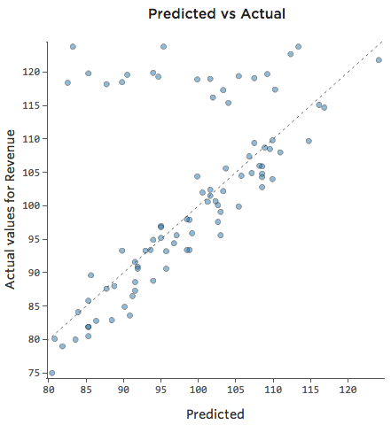
Ways to improve your Model
Missing Variables
Interactions Between Variables
Perhaps on weekends the lemonade stand is always selling at 100% of capacity, so regardless of the temperature, revenue is high.
But on weekdays, the
lemonade stand is much less busy,
so Temperature is an important
driver of Revenue.

Slide 60
Ways to improve your Model
Missing Variables
Interactions Between Variables
Perhaps on weekends the lemonade stand is always selling at 100% of capacity, so regardless of the temperature, revenue is high.
But on weekdays, the
lemonade stand is much less busy,
so Temperature is an important
driver of Revenue.
If you ran a regression that
included Weekend? and Temperature,
you might see a Predicted vs Actual
plot like this, where the row along the
top are the weekend days.

Slide 61
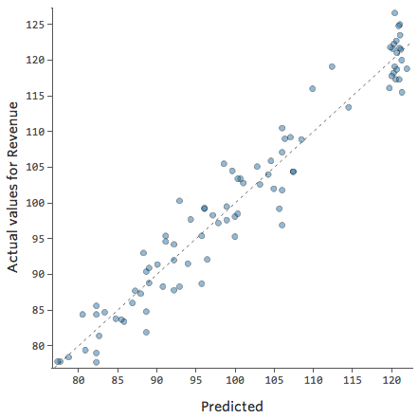
Ways to improve your Model
Missing Variables
Interactions Between Variables
We would say that there’s an “interaction” between Weekend? and Temperature, the effect of one of them on Revenue is different based on the value of the other.
If we create an interaction
Variable, we get a much better model, where Predicted vs Actual looks like this:

Slide 62
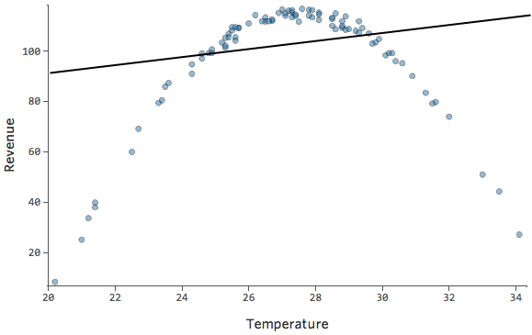
Ways to improve your Model
Fixing Nonlinearity
Let’s say you have a relationship that looks like this:
Notes:
You might notice that the shape there is that of a parabola, which you might recall is typically associated with formulas that look like this:
y = x² + x + 1

Slide 63
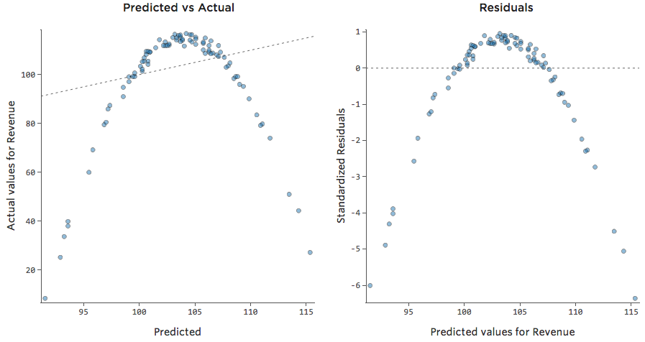
Ways to improve your Model
Fixing Nonlinearity
Diagnostic plot

Slide 64
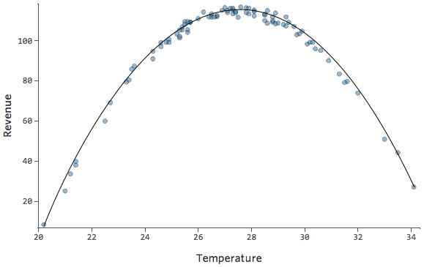
Ways to improve your Model
Fixing Nonlinearity
But it’s a terrible fit. So if we add an x² term, our model has a better chance of fitting the curve. In fact, it creates this:

